Slide 1



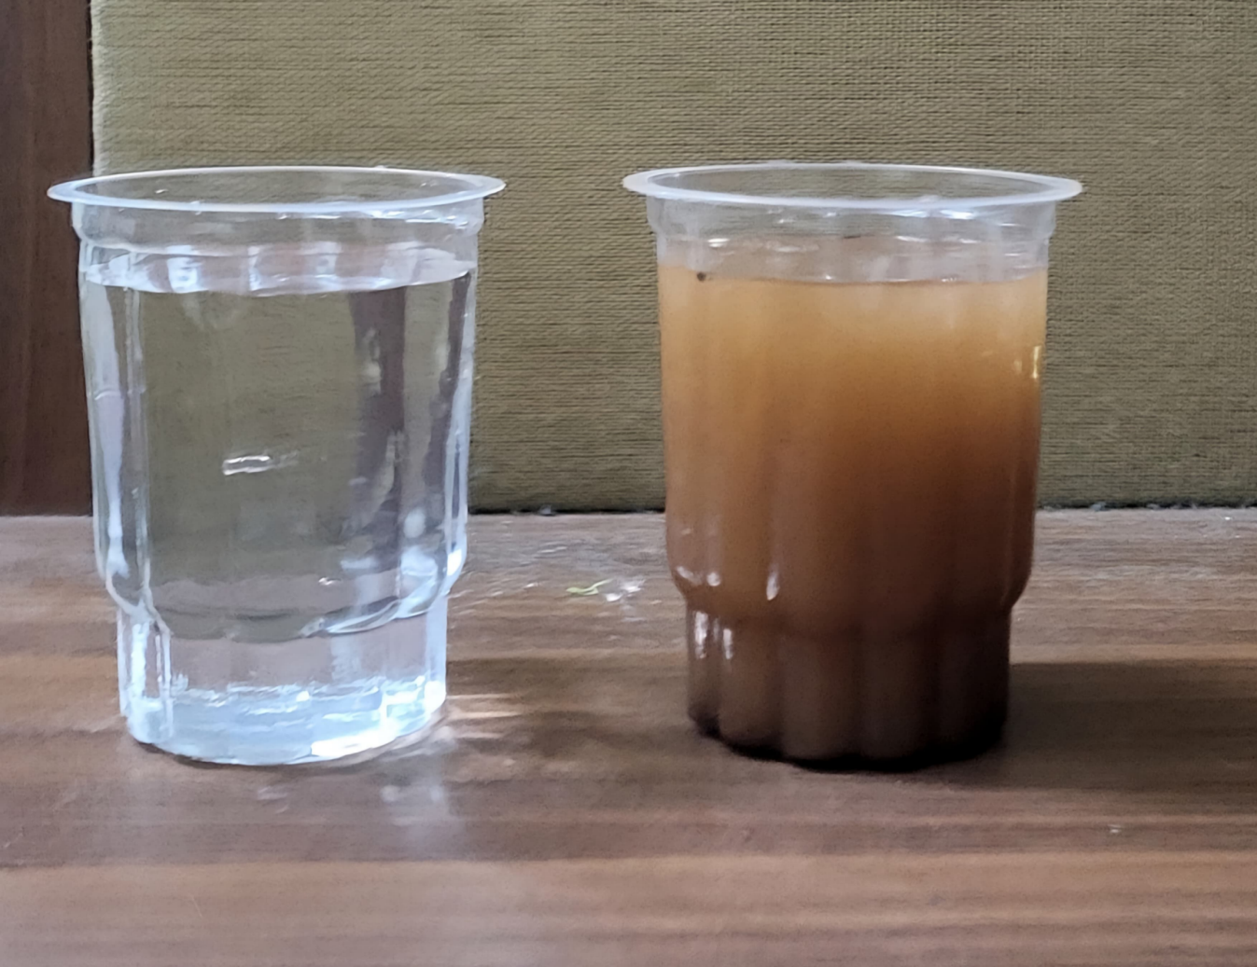
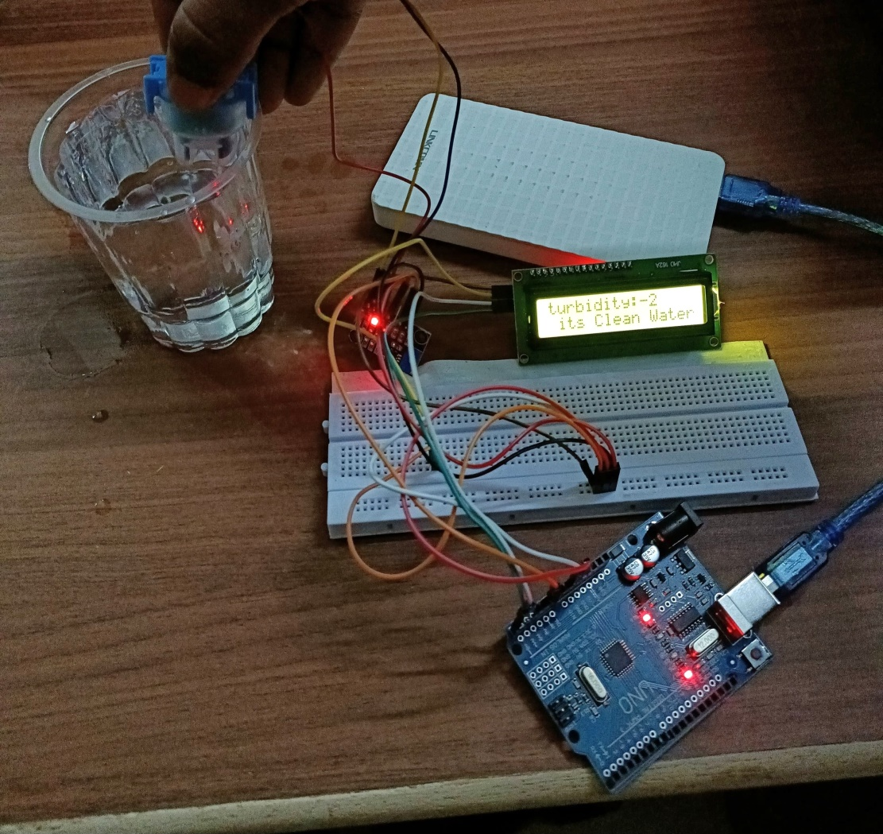
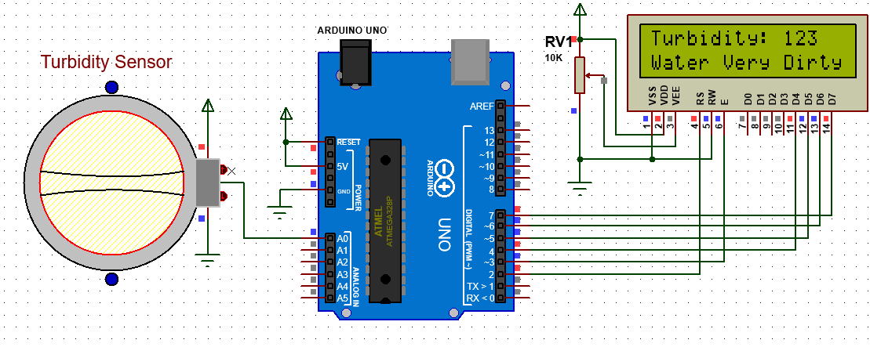
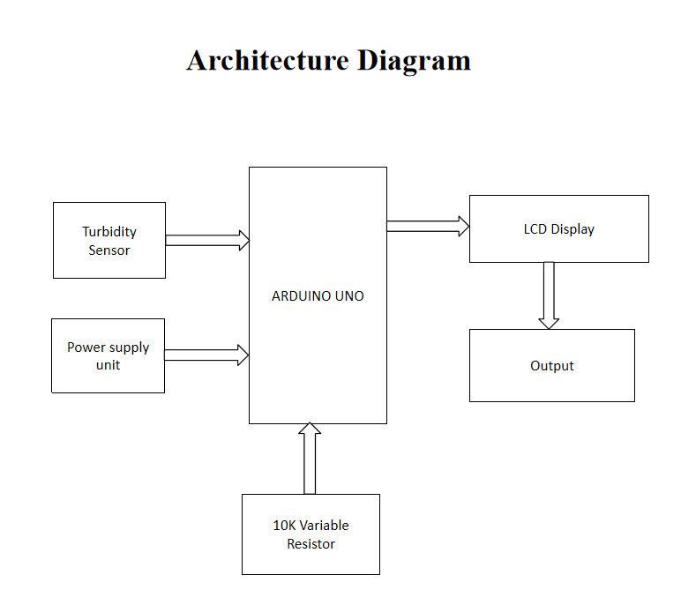
SMART WATER QUALITY MONITORING USING IOT
Department of Information Technology
School of Computing
10214IT602– MINOR PROJECT-II
WINTER SEMESTER 2023-2024
ABSTRACT
INTRODUCTION
RESULTS
STANDARDS AND POLICIES
The aim of the water quality detection project employing an Arduino Uno and a turbidity sensor is to develop a cost-effective and a system for monitoring and assessing water quality. By measuring turbidity levels, this project seeks to detect suspended particles, sediments, or pollutants in water, contributing to environmental conservation efforts by identifying potential pollution sources or changes in water quality. To prevent water pollution nowadays it becomes very essential to monitor water pollution. IOT based system is one of the most automated and applicable tools for water pollution monitoring.
The IoT-based system for water pollution monitoring involves the use of sensors to measure the physical and chemical parameters of water in real-time. The data collected by the sensors is transferred to a central server or cloud service, where it is analyzed to determine the level of water contamination. The system then makes recommendations for precautionary measures based on the analysis. Several studies have developed real-time automated IoT-based systems for water quality monitoring using various sensors, which can be used for monitoring and management of water quality in various applications.
The Arduino Integrated Development Environment (IDE) is a software platform used to write, compile, and upload code to Arduino microcontrollers like the Arduino Uno. It provides an easy-to-use interface for programming and developing projects for various Arduino-compatible boards.
Standard Used: ISO 5667-11
The high use of chemicals in manufacturing, construction and other industries, fertilizers in farms and also directly leaving the polluted water from industries into nearby water bodies have made a huge contribution to the global water quality reduction, which has become an important problem. Even due to containment water various water born are increasing day by day, due to which many human beings are losing their lives. Traditionally, detection of water quality was manually performed where water samples were obtained and sent for examination to the laboratories which is time taking process, cost and human resources. Such techniques do not provide data in real-time. The proposed water quality monitoring system is consisting of a micro controller (Arduino UNO) and basic Turbidity Sensor. The system can detect the water quality using the turbidity sensor.
Figure 1. Input .
Figure 2. Output
Circuit Diagram:Smart Water Monitoring
CONCLUSIONS
METHODOLOGIES
The implementation of an IoT-based water quality detection system involving a turbidity sensor presents a promising and innovative approach to monitor and assess water quality in various environments.
The IoT-based system for water pollution monitoring involves the use of sensors to measure the physical and chemical parameters of water in real-time. The data collected by the sensors is transferred to a central server or cloud service, where it is analyzed to determine the level of water contamination. The system then makes recommendations for precautionary measures based on the analysis. Several studies have developed real-time automated IoT-based systems for water quality monitoring using various sensors, which can be used for monitoring and management of water quality in various applications.
TEAM MEMBER DETAILS
The IoT-based system for water pollution monitoring involves the use of sensors to measure the physical and chemical parameters of water in real-time. The data collected by the sensors is transferred to a central server or cloud service, where it is analyzed to determine the level of water contamination. The system then makes recommendations for precautionary measures based on the analysis. Several studies have developed real-time automated IoT-based systems for water quality monitoring using various sensors, which can be used for monitoring and management of water quality in various applications.
1.VTU 20666/MANIKANTA NAIDU.M
2.VTU 21080/R.CHANDU DILEEP
3.VTU 20604/K.SHARATH KUMAR
1.7671019451
2.9652249115
3.9381515483
1.vtu20666@veltech.edu.in
2.vtu21080@veltech.edu.in
3.vtu20604@veltech.edu.in
ACKNOWLEDGEMENT
Supervisor Name : Mr. D RAMYA, M Tech., /Assistant Professor
Contact No : 9843801898
Mail ID : raminfo84@gmail.com
Architecture Diagram:Smart Water Monitoring

